Slide 1
Social Entrepreneurship as a Key Factor of Social Inclusion, Integration and Sustainable Development of Temi Cummunity
Tartu
2017

Slide 2
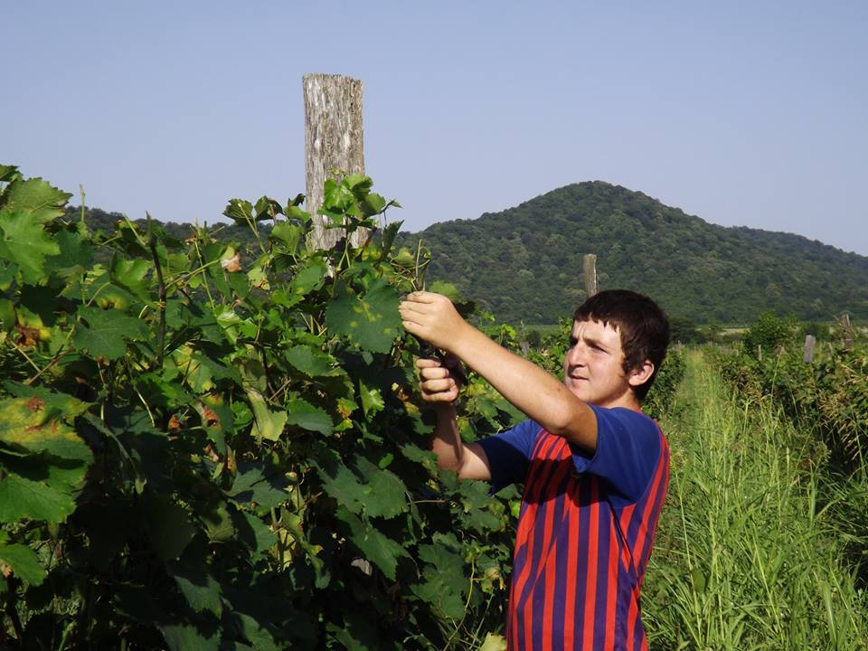
Temi Community
TEMI COMMUNITY is situated at the foothills of the Caucasus Mountain, in a village GREMI in Kvareli District of KAKHETI.

Slide 3
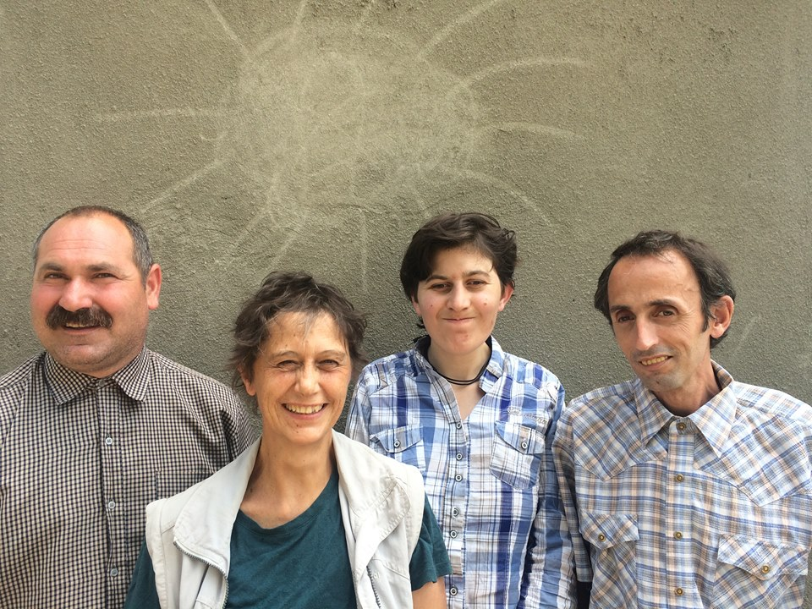
Our Story
TEMI CHARITABLE UNION was first started as a charity in 1989 to help the socially disadvantaged
TEMI COMMUNITY was founded in 1991 and over the years the family grew to more than 100 people of different ages

Slide 4
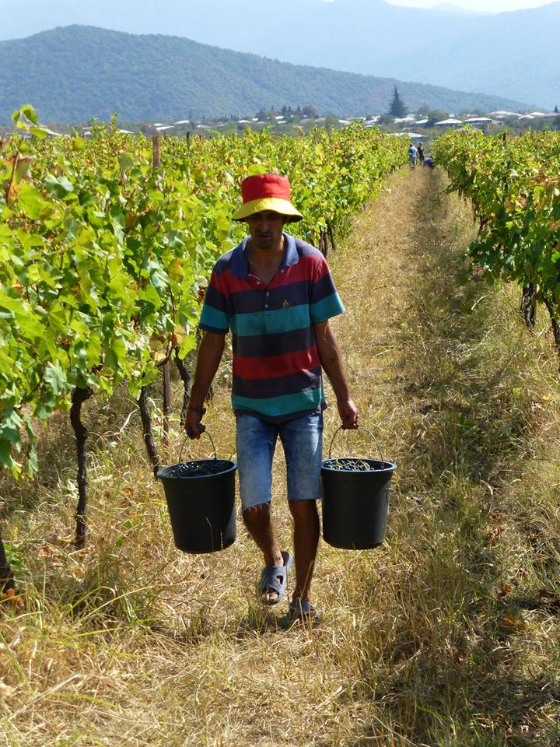
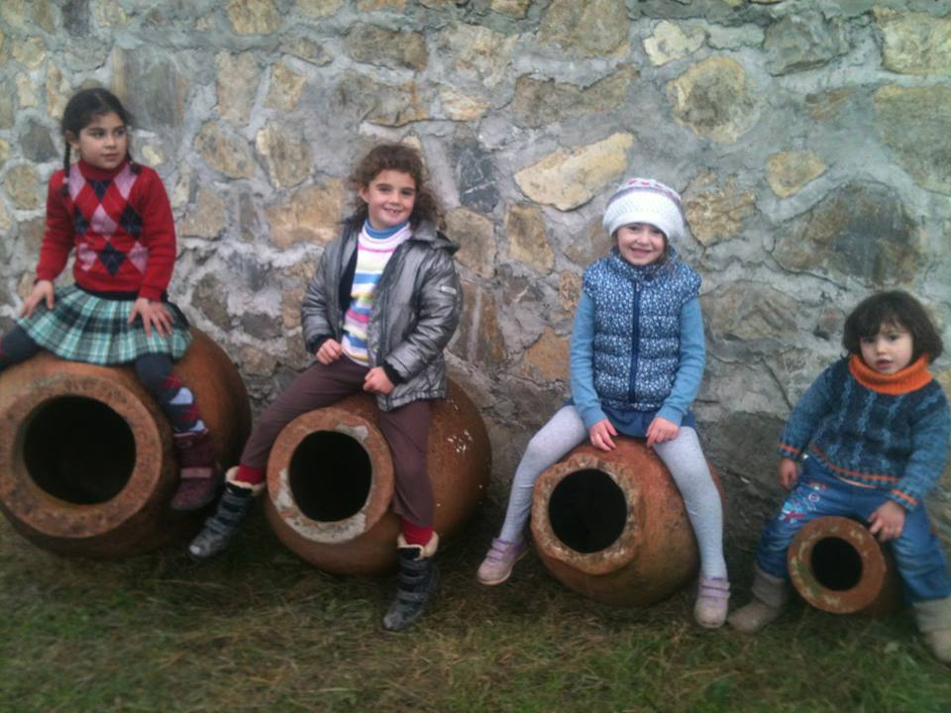
Our Story
Temi Charitable Union unites people with mental disabilities, teenagers from the orphanage (who lost their social background after finishing their compulsory education) and people in need, coming from shattered families

Slide 5
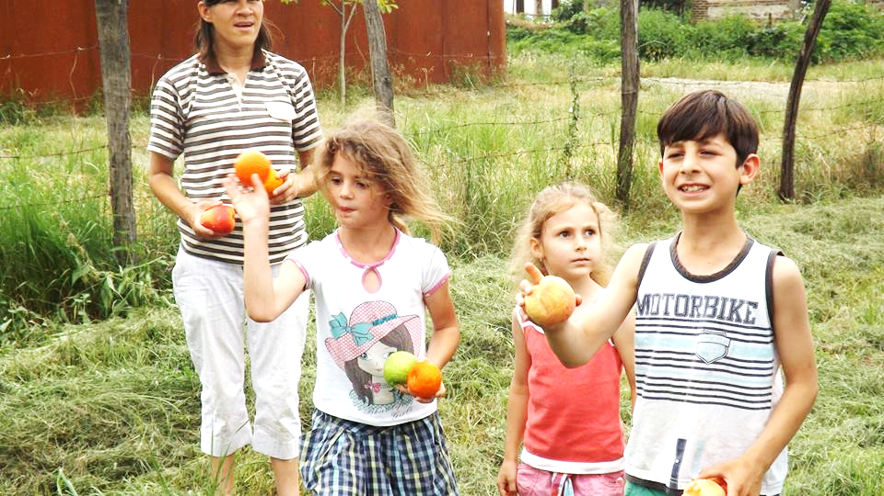
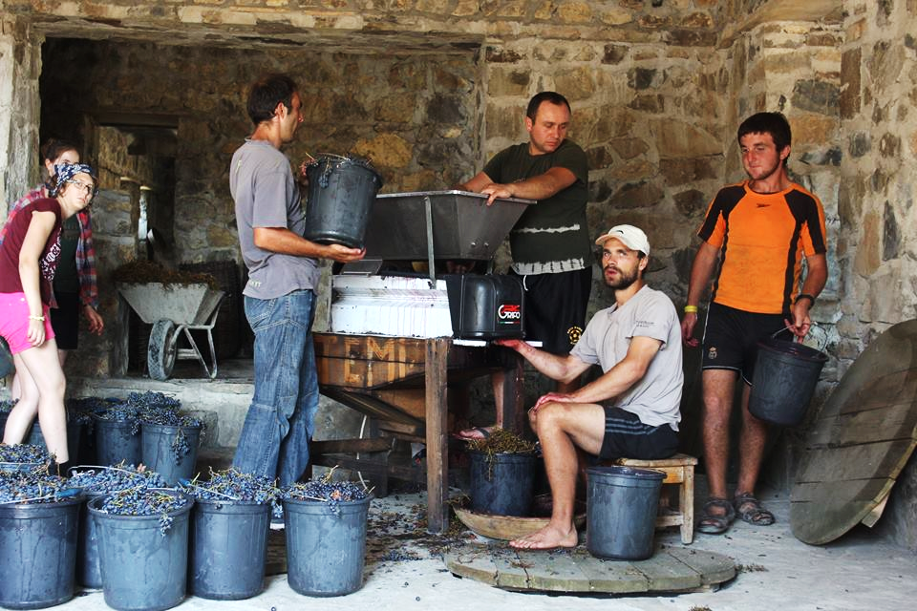
Goals
To provide a safe and stimulating environment in which socially vulnerable people can develop to their full potential;
To achieve “I” above via social enterprise; developing TEMI’s capacity to earn an income in order to be self-sustainable and to ensure our long-term survival;
To achieve both “I” and “II” above via environmentally friendly treatment of the earth and nature, so as not to sacrifice moral values and common good to a short-term gain.

Slide 6
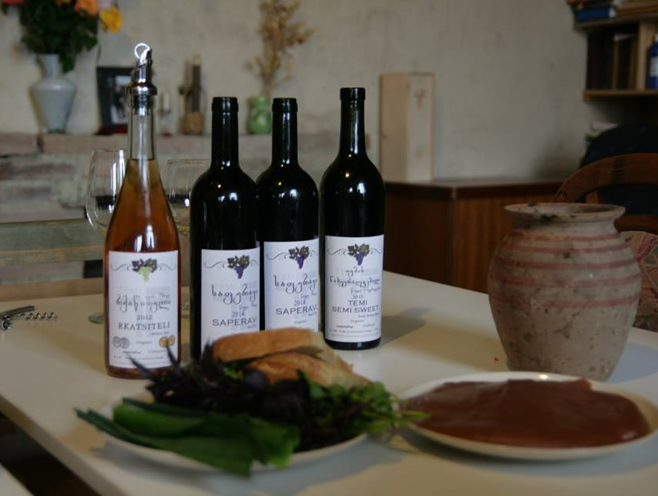
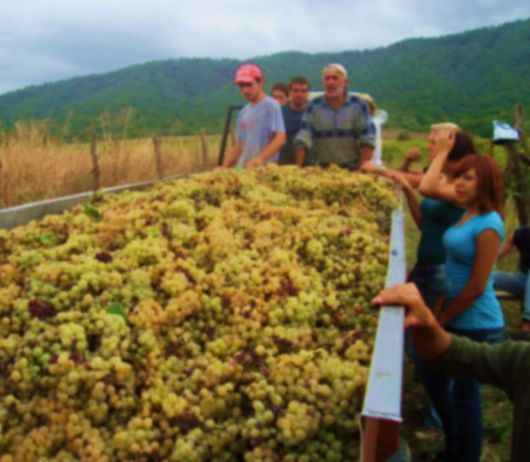
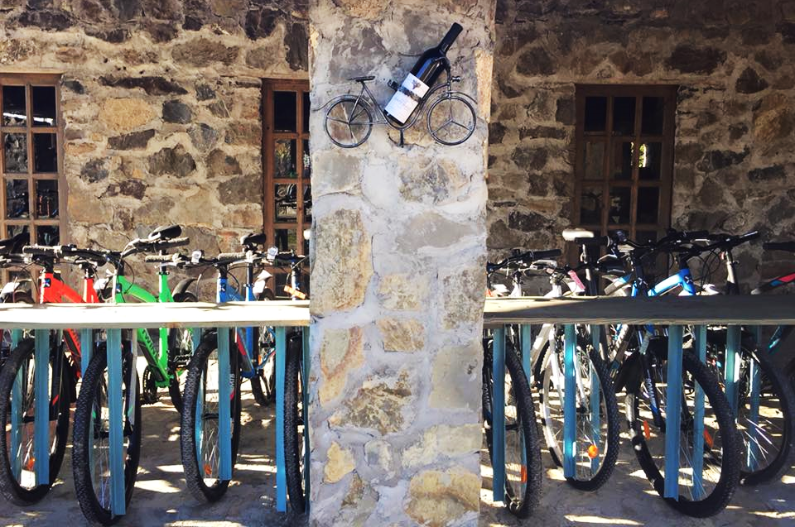
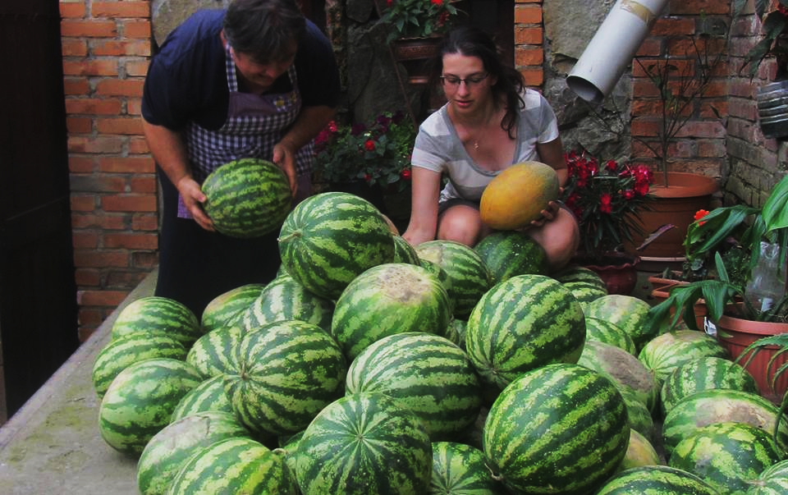
Social Entrepreneurship
TEMI Charity is a social enterprise working on enhancing social integration practices, increasing employment opportunities and the economic resilience of communities
TEMI’s ongoing social enterprises include vegetable gardens, greenhouse, vineyards, bakery, carpentry, bike tourism, culinary tourism and others, all in accordance with organic/bio standards.
TEMI owns 23 hectares of land including 7 hectares of organic vineyard

Slide 7
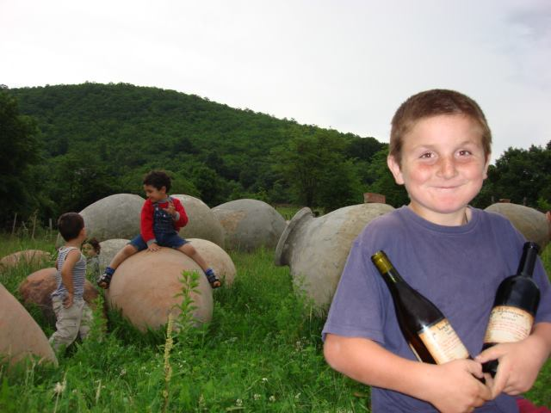
Why Temi Charity as a Social Enterprise
TEMI community works as a social enterprise in order to sustain a safe and stimulating environment in which socially vulnerable people can develop to their full potential. TEMI believes in environmentally friendly treatment of the earth and nature, so as not to sacrifice moral values and common good to a short-term gain.

Slide 8
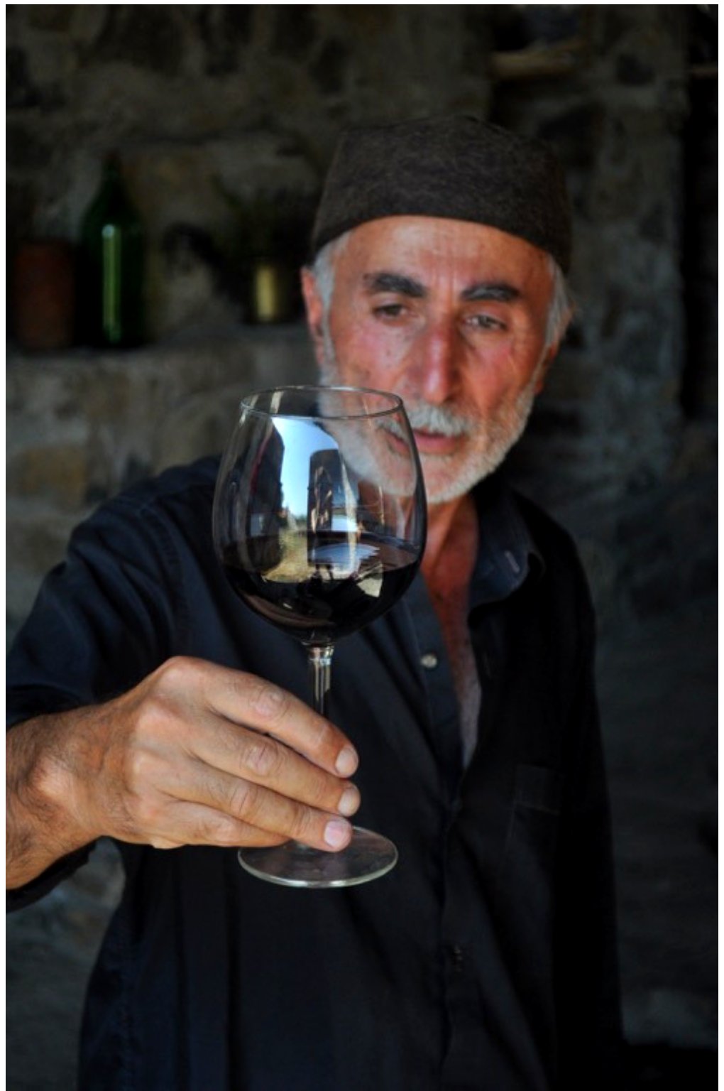
WINE TOURISM
Wine cellar
A traditional wine cellar housing 24 qvevri clay vessels underground in two stone built halls. More than 50 tons of wine is matured here
Organic Wine tasting - Rkatsiteli, Saperavi, Kindzmarauli
TEMI grows traditional grape varieties Rkatsiteli and Saperavi .
30 000 bottles of wine is producing annually
Temi’s vineyards, are certified organic by EU-accredited “Caucascert” (reference #CC-AB-063-031)

Slide 9
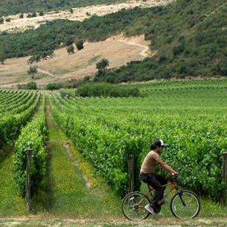
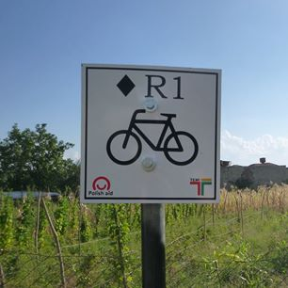
RESTAURANT & BIKE RENTAL
A stunning restaurant and an open space for culinary lessons, which is complemented by an adjacent wine bar crafted from wood
Only organic food is served in the restaurant
Visitors can enjoy a scenic cycling tour of three difficulties.
Bike trials goes through the vineyards, old monuments and villages.
All bike routs are marked and specially created mobile-application guides during the whole trip
Restaurant & Bike rental service is innovative model in East Georgia

Slide 10
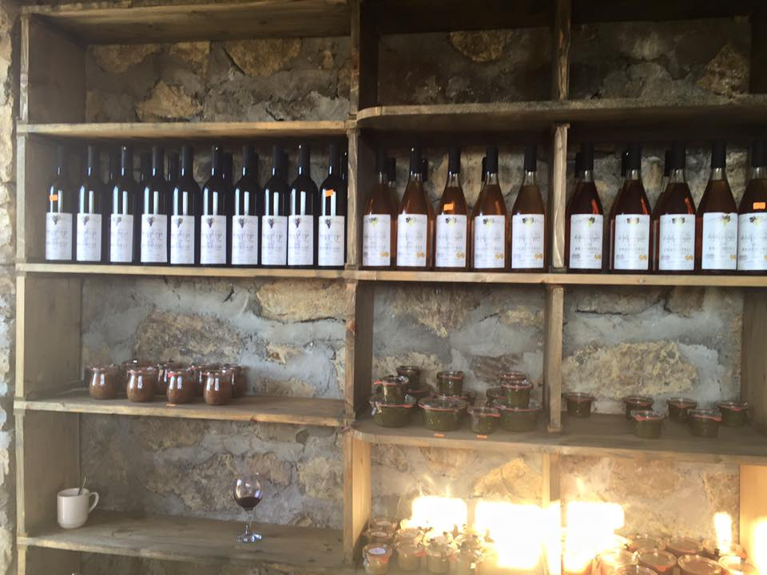
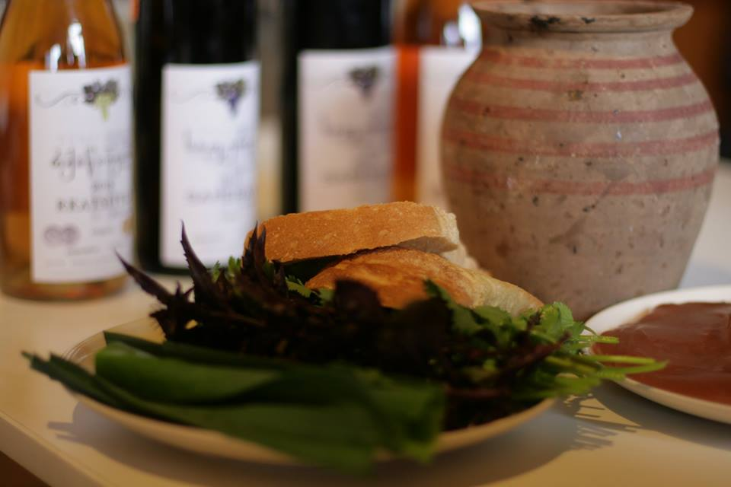
SOCIAL SLOW FOOD
TEMI Charity produces Kakheti 100% natural food products. All fruit and vegetables used for the production of preserves come from TEMI’s garden.
Social slow food products - Mustard, chutneys, walnut butter, ham, cheese – is sold in the store located on the terrain of Temi Charity in Gremi
TEMI’s approach is different: TEMI is not asking for donations, instead TEMI is inviting YOU to become our satisfied customer

Slide 11
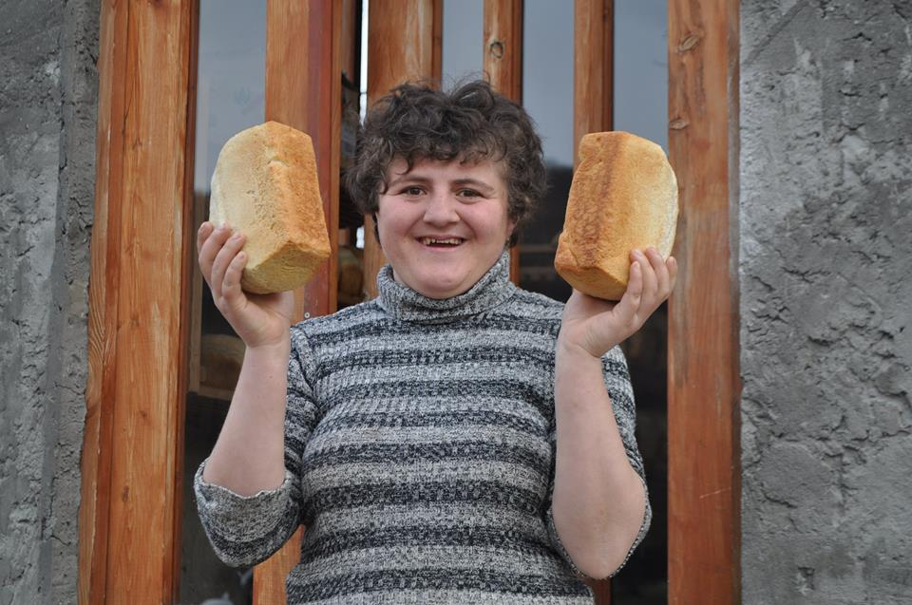
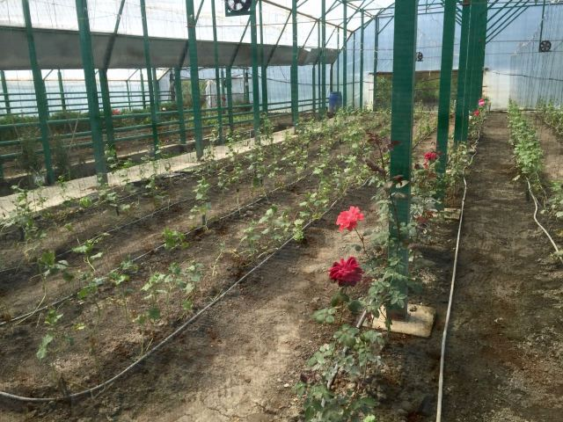
WHEAT CULTIVATION & GREENHOUSE
Wheat cultivation aims to promote sustainable management of biodiversity. Temi Charity cultivates an indigenous wheat variety, Tsiteli Doli. Wheat is used to produce high quality bread products for consumption
In the greenhouse several different vegetables and herbs are cultivated including zucchini, salads, beans, tomatoes, eggplants, peppers...

Slide 12
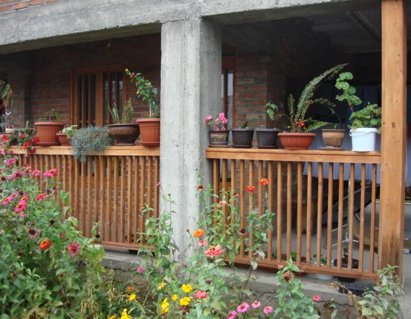
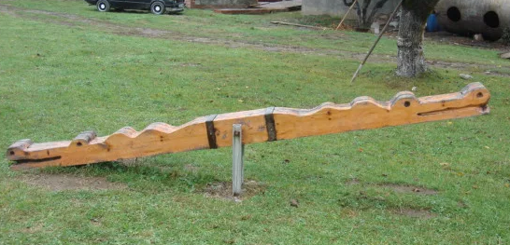
CARPENTRY
Temi property includes a carpentry workshop. Provided with a circular saw, planers and other tools, furniture and equipment is designed and created. This enables Temi Charity to make all furniture, windows and doors that is needed for themselves and also to make an income from selling their products.
Main goal is to assign meaningful activities and tasks to beneficiaries.

Slide 13
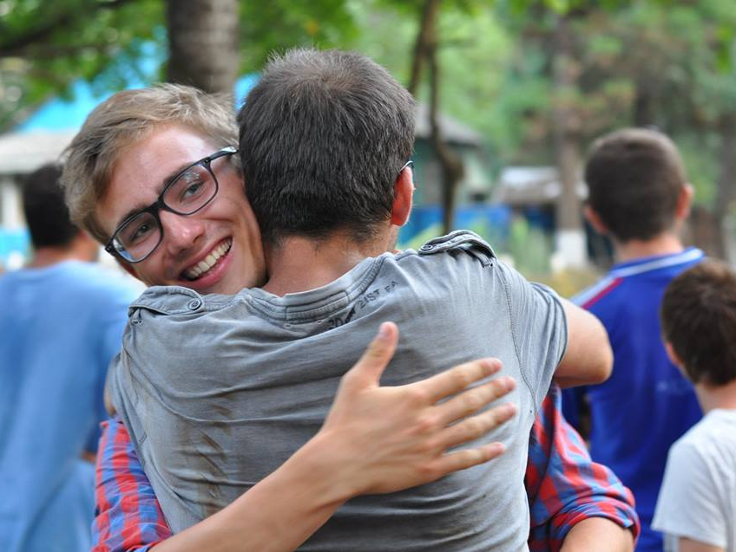
Temi Charity welcomes volunteers from all over the world
They are included into the Temi family, and fulfill an important and appreciated role. We want volunteers to get the most out of their time here, while contributing to the life of the community. As such we work with volunteers to define their best suited roles and responsibility. Volunteers are a crucial and valued part of life at Temi. Usually a group of 4-5 volunteers permanently live and work in Temi.
Partner-Volunteer Organisations
TravelAid
WWOOF
Freunde der Erziehungskunst LYVG
Weltwerts DE

Slide 14
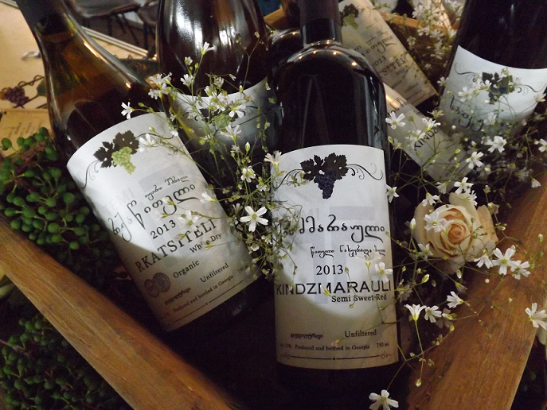
Exhibitions and Awards
At the 2013 Wine and Spirits Exhibition “WinExpo Georgia” TEMI Rkatsiteli organic wine was awarded the Silver Medal, and in 2014 and 2015 it won Gold Medals.

Slide 15
International Partners

Slide 16
Thank you
Temi/Gremi Village, Kakheti Region, Georgia
www.temi-community.org
https://www.facebook.com/TEMI.community/

