Slide 1
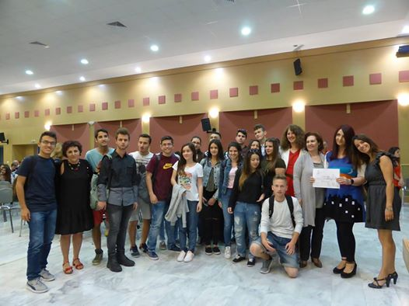
Migration over the Aegean Sea
Humanity endangered
1st High School of Metamorfosis
School year: 2015-16

Slide 2
Coral, the tree of expectations!

Slide 3
Icebreaker games

Slide 4
Brainstorming & Talking stick

Slide 5
Christmas Bazaar

Slide 6
Boats and principles of hospitality

Slide 7
World map & ejatlas

Slide 8
Role-playing: Request for political asylum

Slide 9
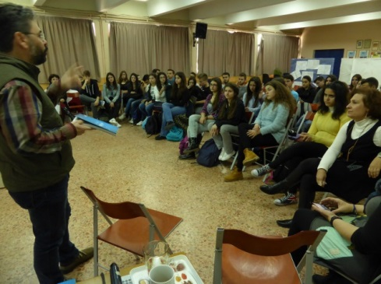
Inviting Soloup in school

Slide 10
Still image & Symposium of Hunger

Slide 11
Centre of Environmental Education in Argyroupoli: sea passages

Slide 12
Meeting refugees on the field: Alimos beach

Slide 13
«A backpack for the road»

Slide 14
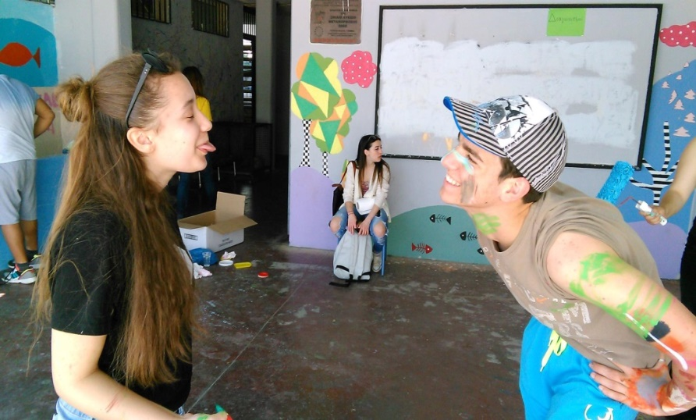
Park of National Reconciliation-Grammos Mountain
Let’s Do It Greece!

Slide 15
Presentation and Awards

